Slide 1
Typhoon Kompasu
ESCAP/WMO Typhoon Committee Integrated Workshop Macao, China
Sept. 7, 2010
Dr. Waon-Ho(Tiger) Yi
Chair of WGDRR
Prof. of Kwangwoon University
Former Director of NIDP
Notes:
1

Slide 2
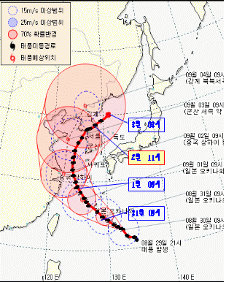
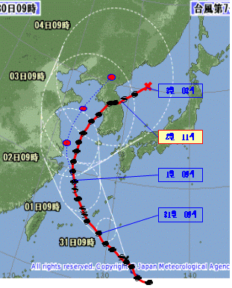
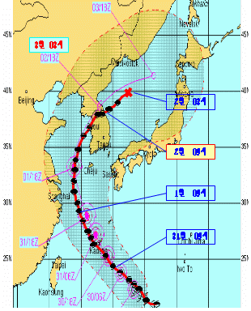
Trajectory of Typhoon Kompasu
Comparisons of Typhoon Trajectory Estimation
  JTWC estimates best trajectory of typhoon COMPASU
  KMA JMA JTWC

Slide 3
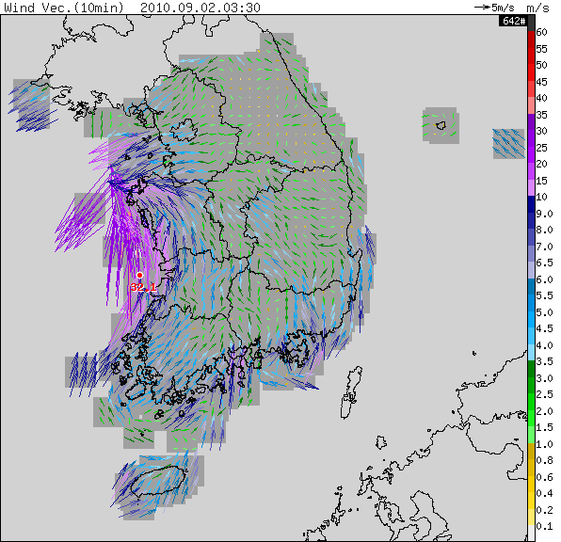
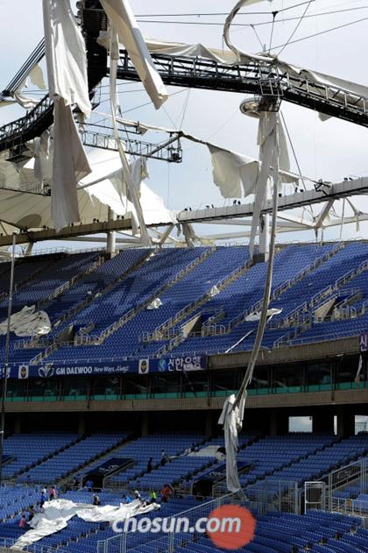
인천 문학경기장 지붕파손 당시 주변 바람장 분포
AWS 바람 동영상(2010.09.02.03:30-08:00KST, 10분간격)
조선일보(2010.09.03)

Slide 4
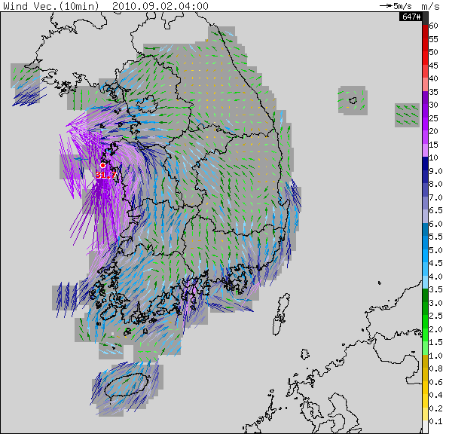
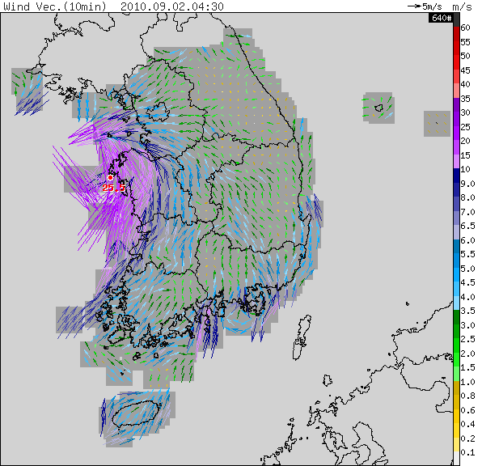
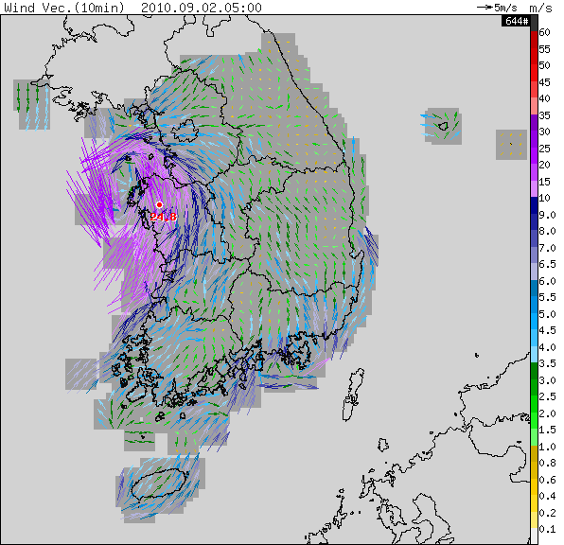
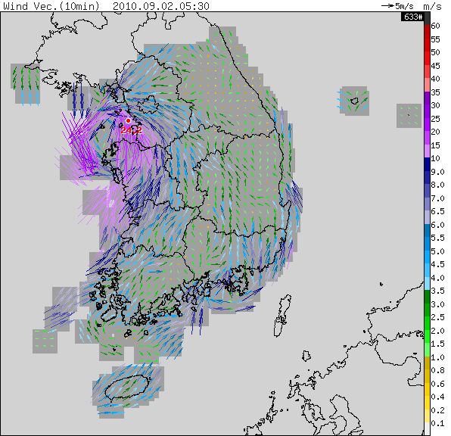
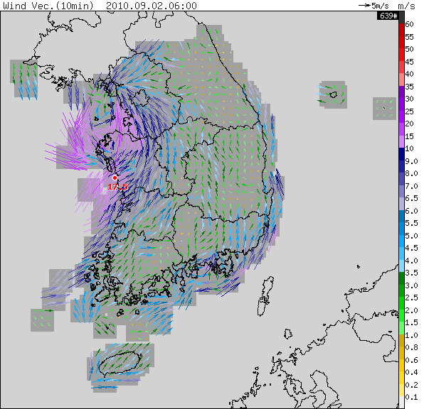
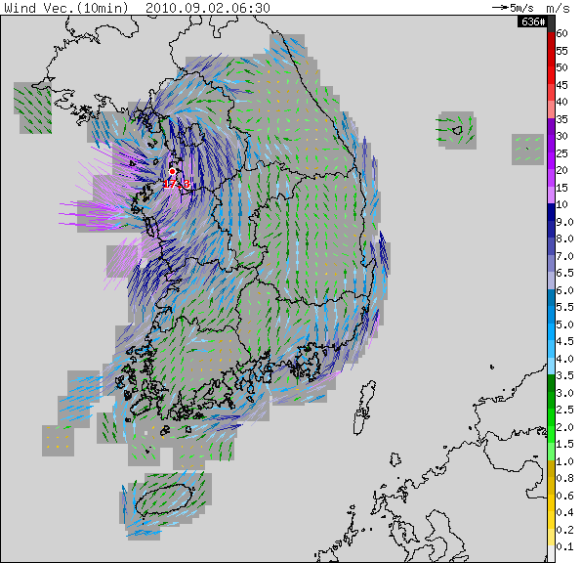
인천 AWS 바람분포 (2010.09.02 04:00-06:30KST, 30분 간격)

Slide 5
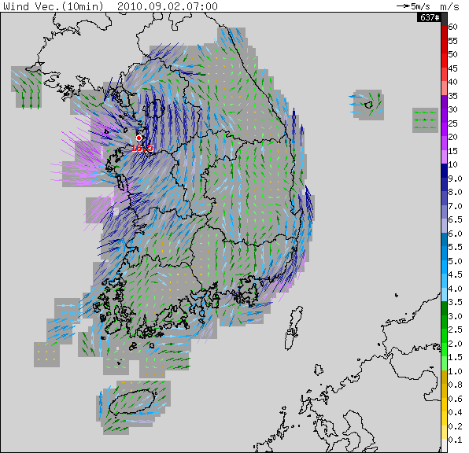
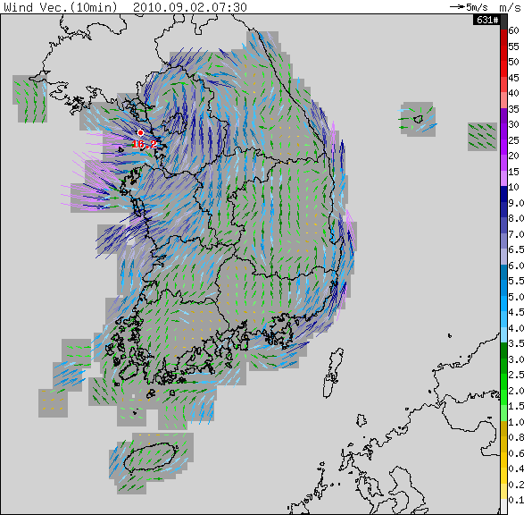
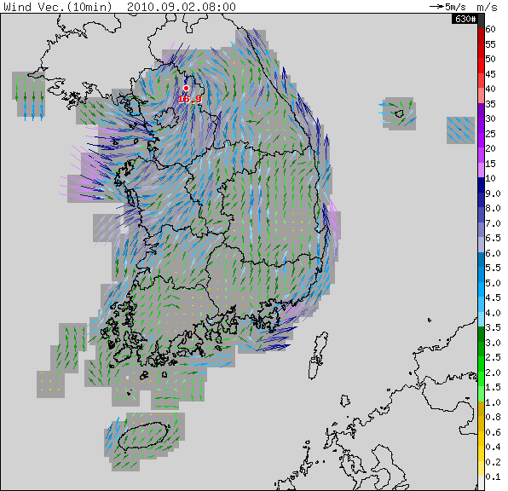
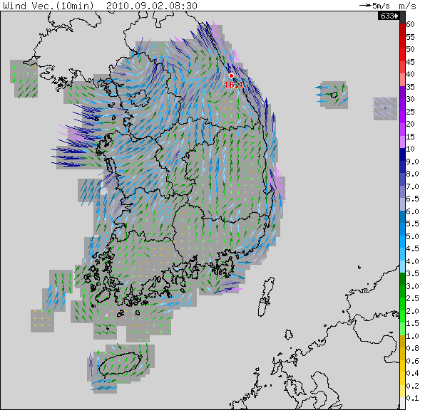

인천 AWS 바람분포 (2010.09.02 07:00-09:00KST, 30분 간격)

Slide 6
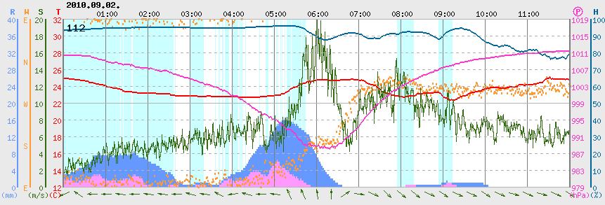
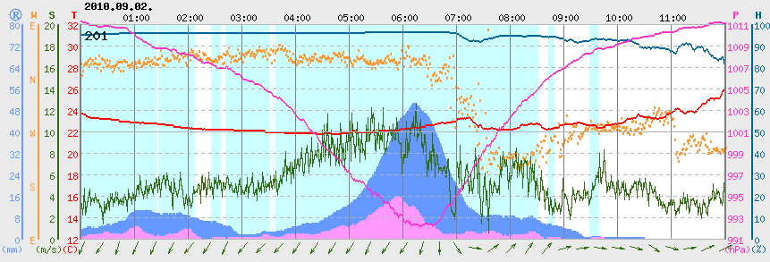
AWS 바람 시계열 분포
인천
강화

Slide 7
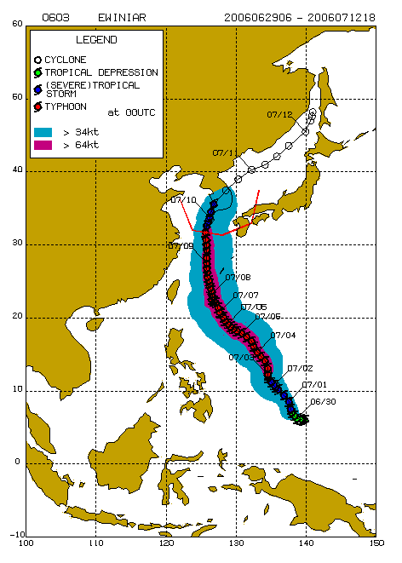
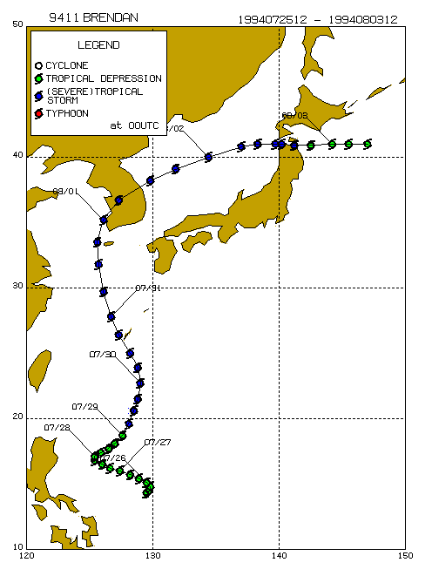
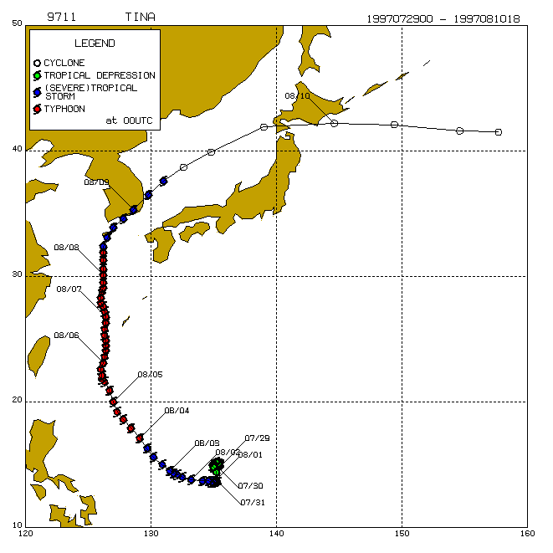
Trajectory of Typhoon Compasu
Comparisons of Similar Typhoon Trajectory
  Ewnia (2006) Brenden (1994) Tina (1997)
-Rainfall : 970㎜, 89mm 987mm
-Death : 5 person 28person 2person
-Damages : 3.4M$ 0.67M$ 0.51M$
-C. Pressure : 970hPa, Wind : 31m/s 992hPa, 30m/s 980hpa, 20m/s
-D.Area CN, GN, GB, Jeju CN, CB, GN, GB CN, GN, GB, Jeju

Slide 8
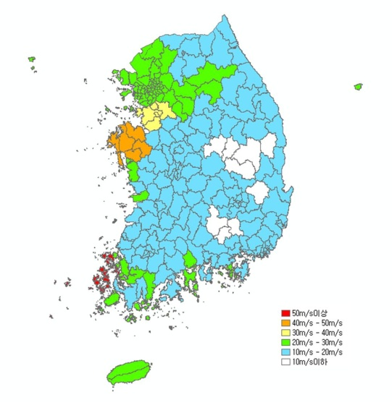
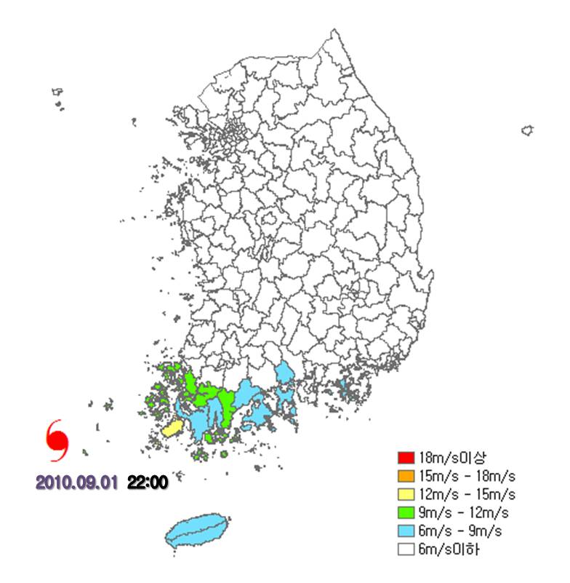
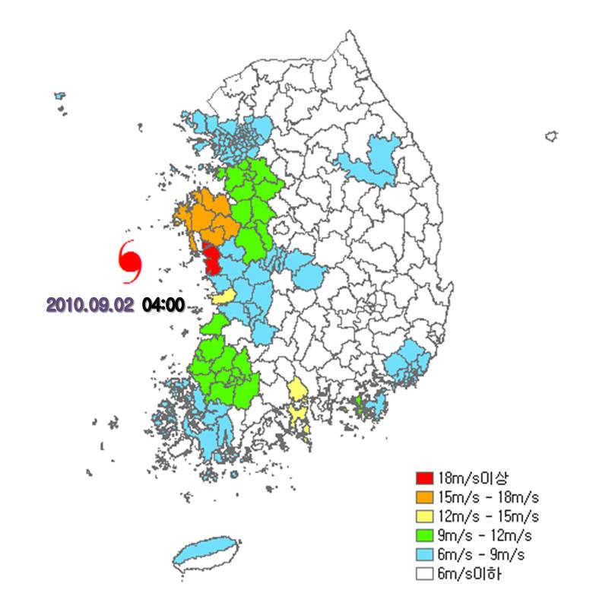
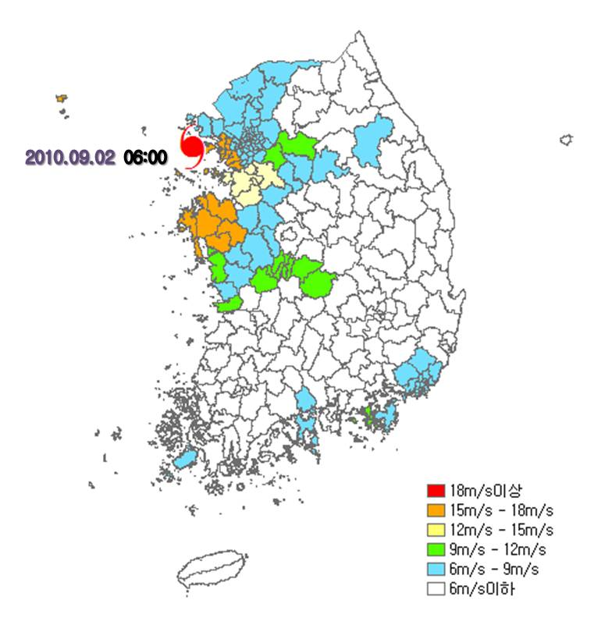
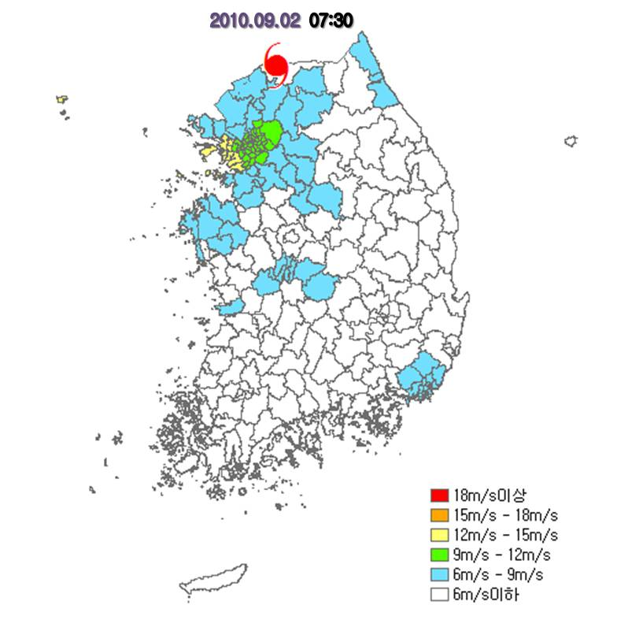
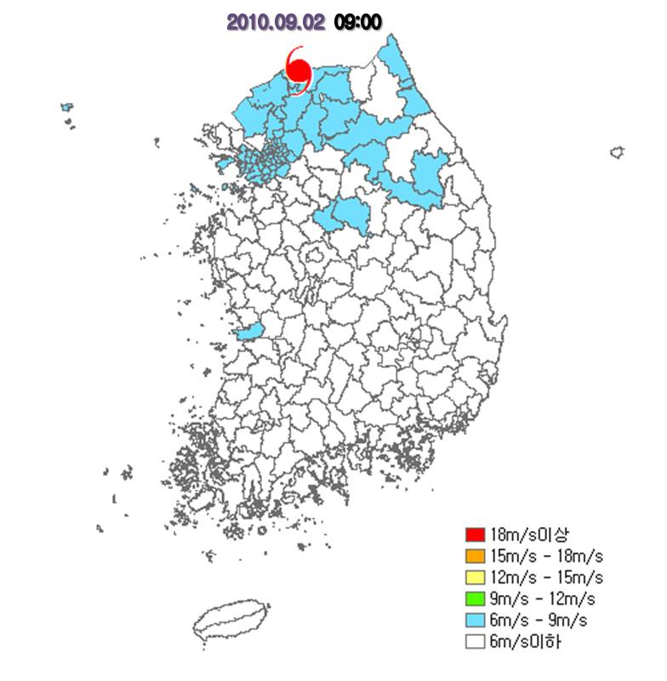
Wind Speed Distribution of Typhoon Compasu
Comparisons of Maximum Wind Speed
  9.1 -9.2 Total 9.1, 22:00(Mokpo) 9.2, 04:00(Gunsan)
  9.2, 06:00(Ganghwa) 9.2, 07:30(Yuejeongbu) 9.2, 09:00(Chuncheon)

Slide 9
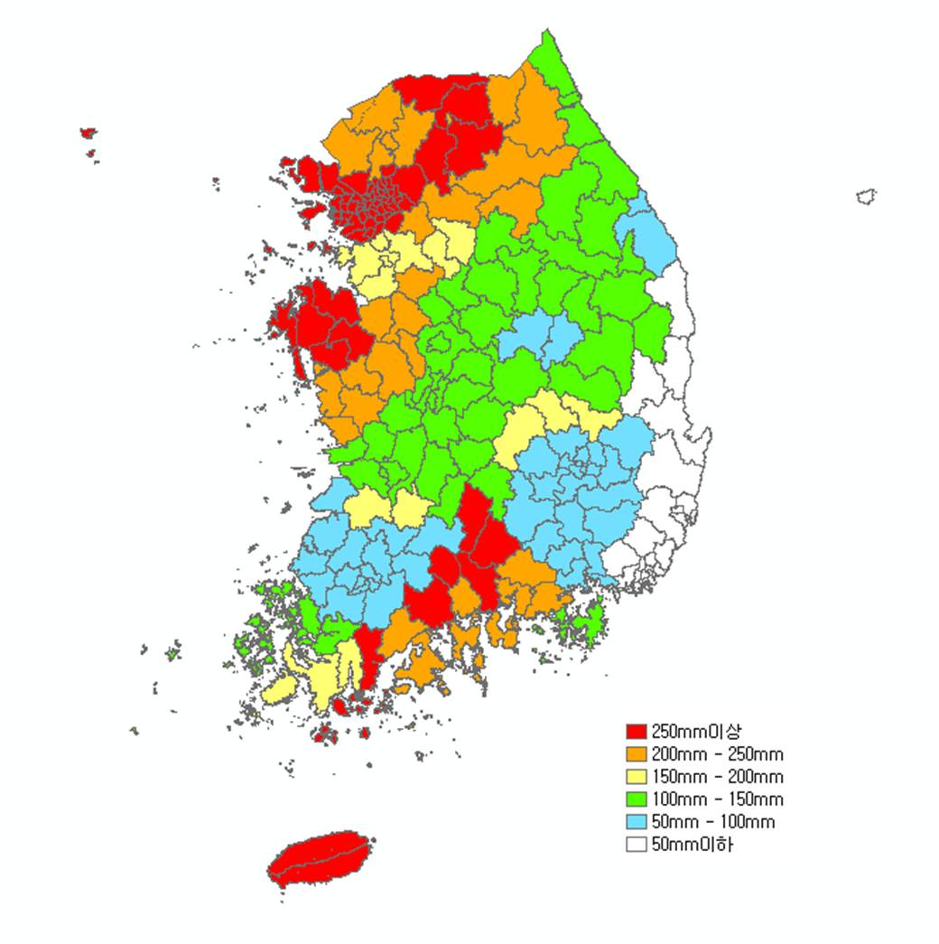
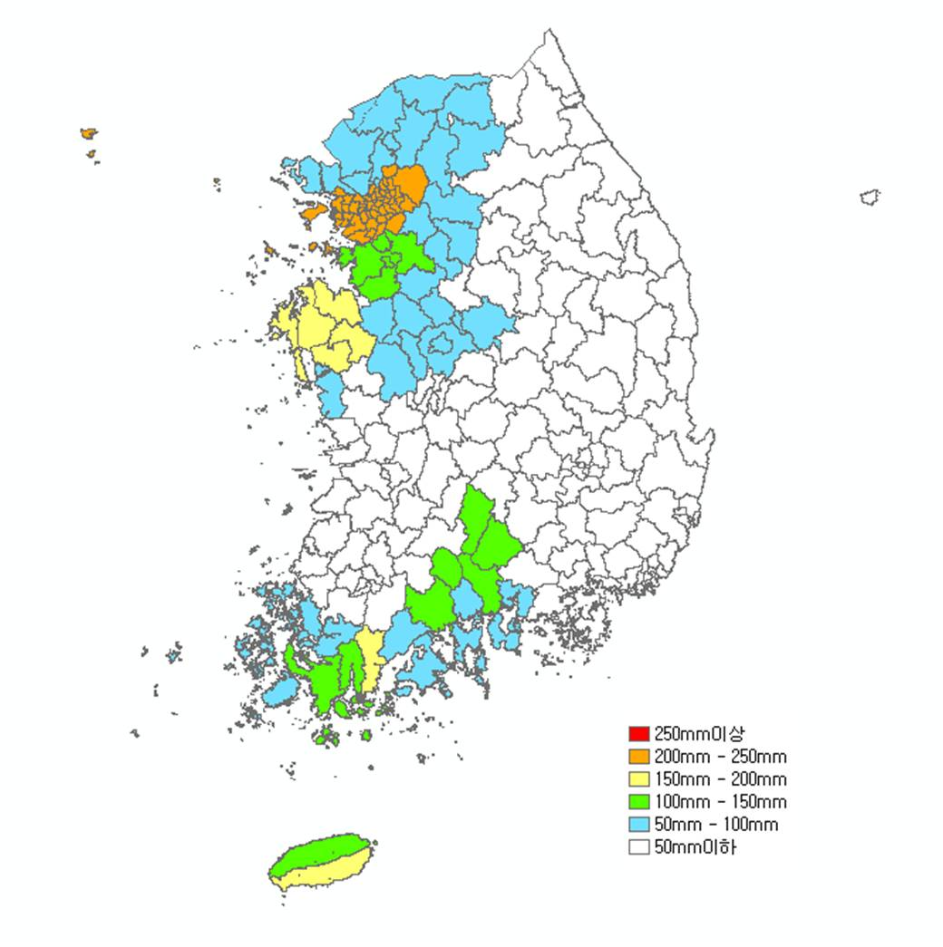
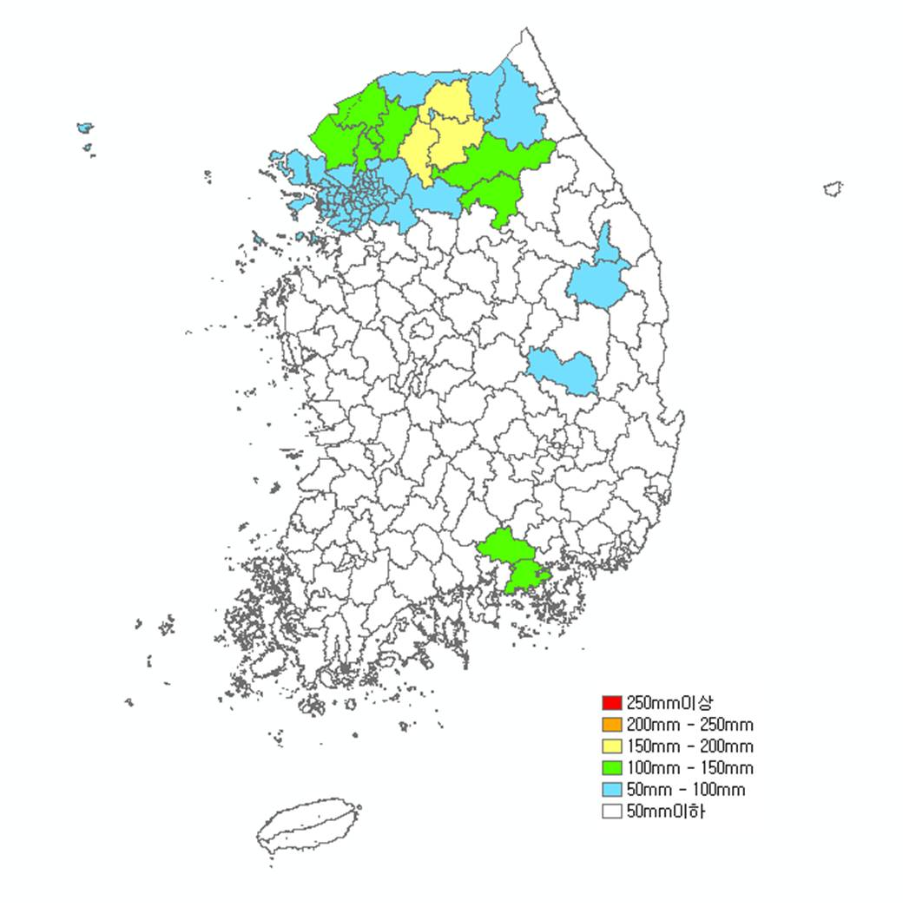
Pre-rainfall before Typhoon Compasu
Pre-rainfall from 8.23 to 8.30
Seoul, GyeongGi, Inchun : 348-365mm
ChungNam, ChunNam, Jeju : 200-329mm

Slide 10
Characterics of Typhoon Patternns
Type of Typhoon Trajectories
Typhoons during 1991-2005 (25)
West Sea (9)
South Sea (9)
South-East Sea (7)
TED (9219)
BRENDAN (9411)
DOUG (9413)
ELLIE(9414)
KAITAK(0004)
RAMMASUN (0205)
MINDULLE (0407)
GLADYS (9112)
SETH (9429)
FAYE (9503)
TINA (9711)
YANNI (9809)
SAOMAI (0014)
RUSA (0215)
MAEMI (0314)
MEGI (0415)
CAITLIN (9109)
MIREILLE (9119)
PERCY (9306)
ROBYN (9307)
OLIWA (9719)
BART (9918)
SOUDELOR (0306)
SONGDA (0418)
NABI (0514)

Slide 11
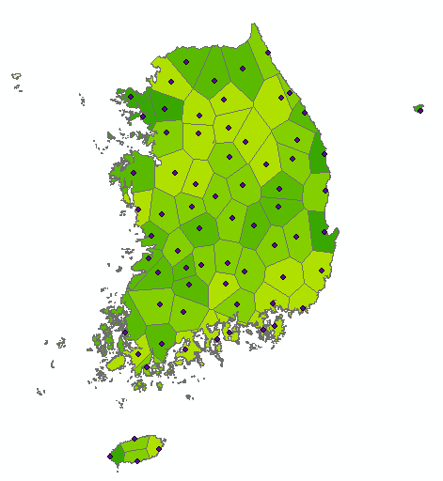
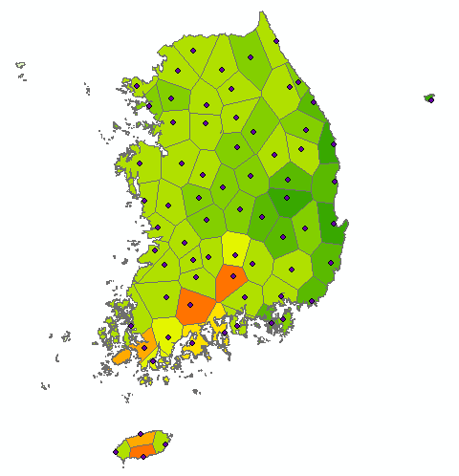
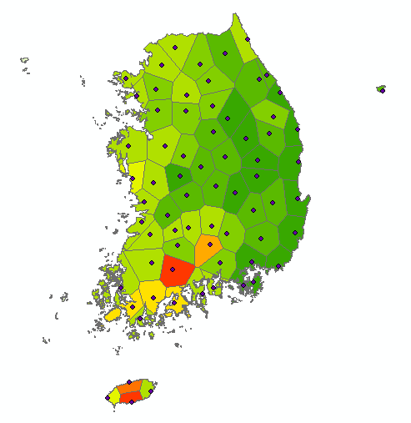
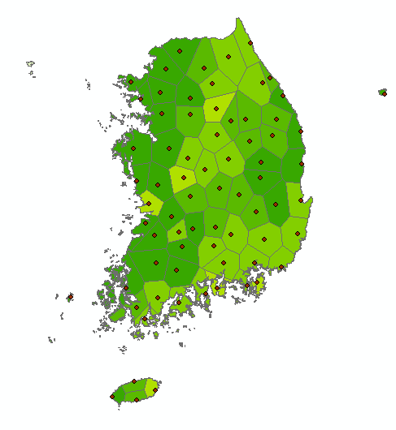
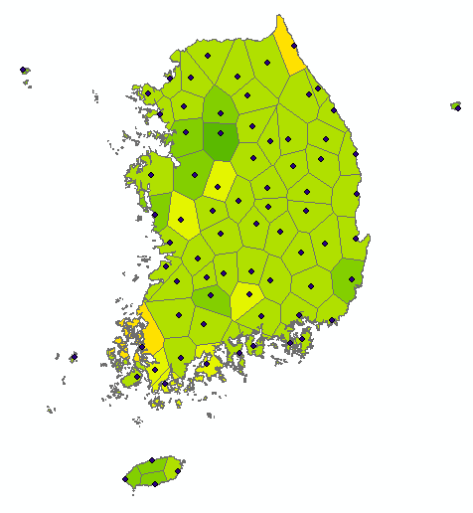
Characterics of Typhoon Patternns
Type of Typhoon Trajectories (West Sea)
Rainfall : 47~151 1000M ton
BRENDAN (9411)
DOUG (9413)
ELLIE(9414)
KAITAK(0004)
MINDULLE (0407)
TED (9219)
BRENDAN (9411)
DOUG (9413)
ELLIE(9414)
KAITAK(0004)
RAMMASUN (0205)
MINDULLE (0407)

Slide 12
Characterics of Typhoon Patternns
Type of Typhoon Trajectories (West Sea)

Slide 13
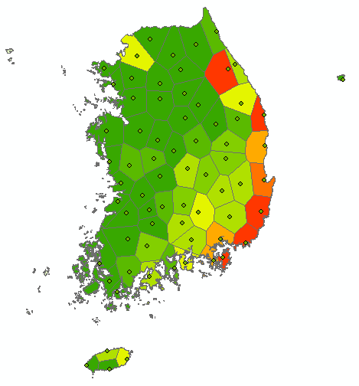
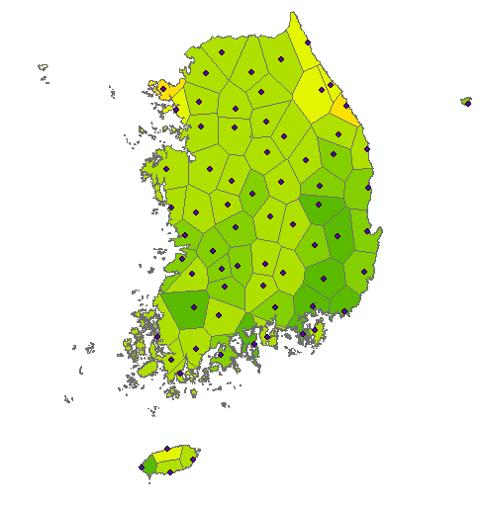
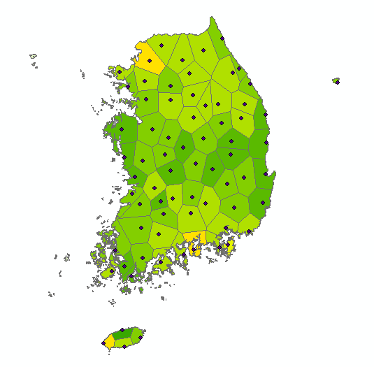
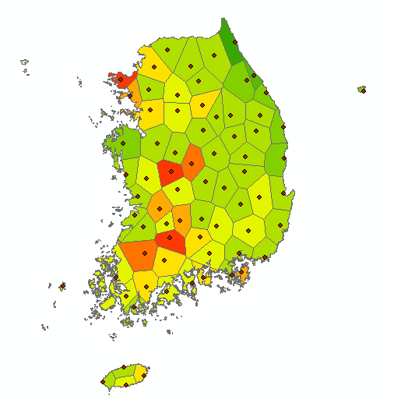
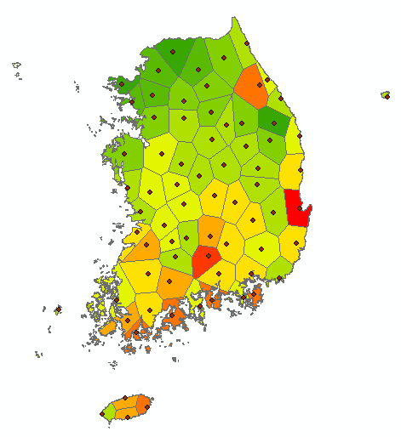
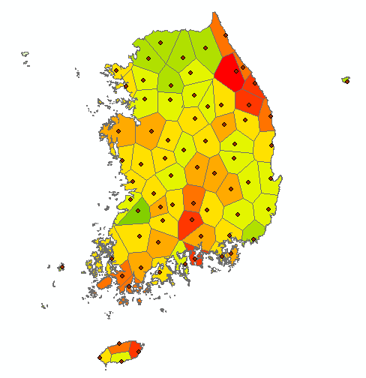
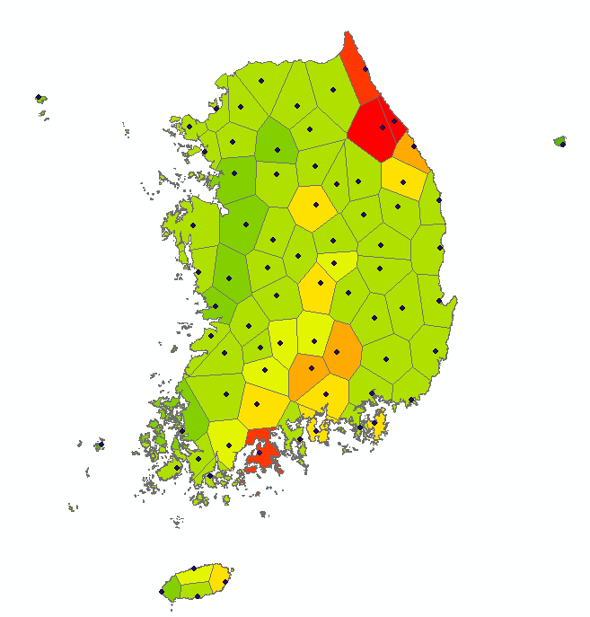
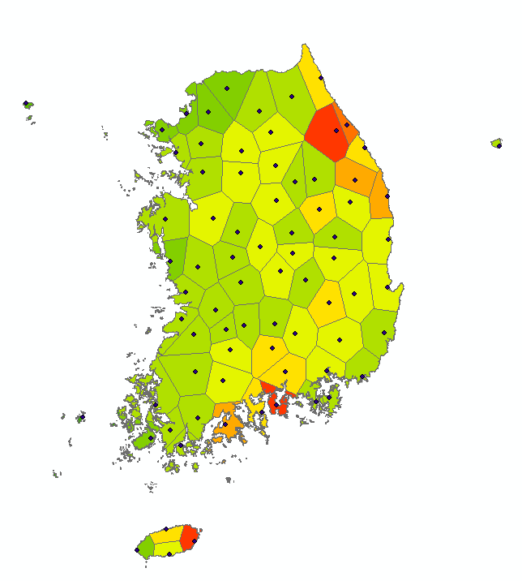
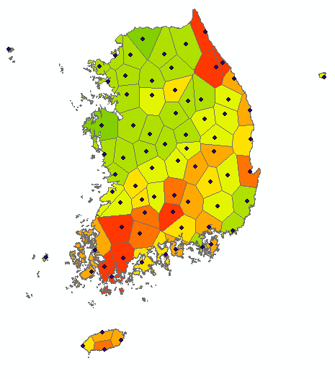
Characterics of Typhoon Patternns
Type of Typhoon Trajectories (South Sea)
Rainfall : 100-300 1000M ton
GLADYS (9112)
SETH (9429)
FAYE (9503)
TINA (9711)
YANNI (9809)
SAOMAI (0014)
RUSA (0215)
MAEMI (0314)
MEGI (0415)
GLADYS (9112)
SETH (9429)
FAYE (9503)
TINA (9711)
YANNI (9809)
SAOMAI (0014)
RUSA (0215)
MAEMI (0314)
MEGI (0415)

Slide 14
Characterics of Typhoon Patternns
Type of Typhoon Trajectories (South Sea)
Max Wind (m/s)
Damages (M USD)
Central Pressure (mb)
Max Wind (m/s)

Slide 15
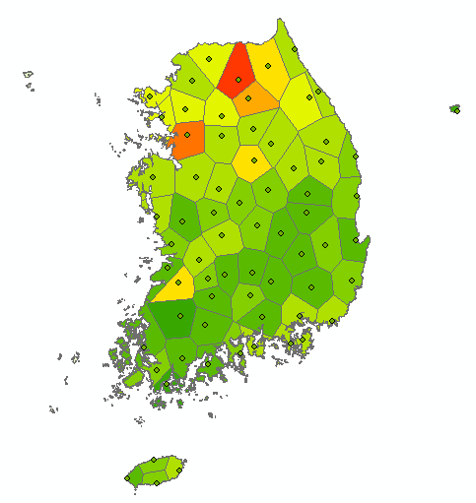
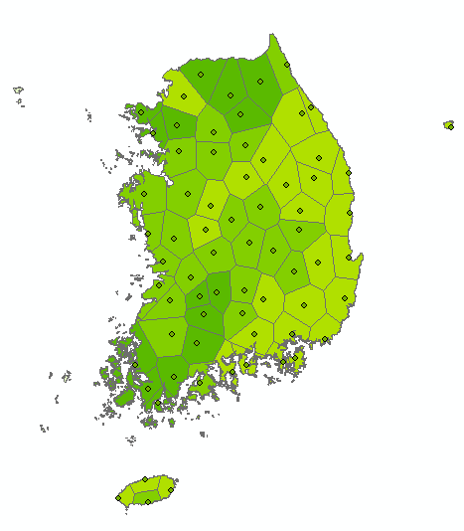
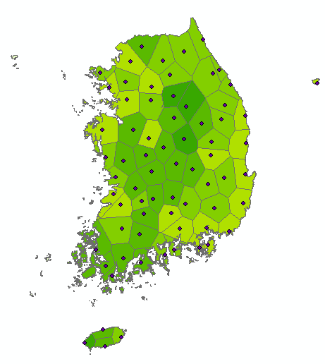
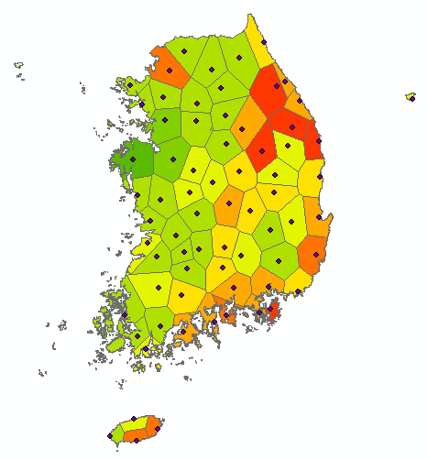
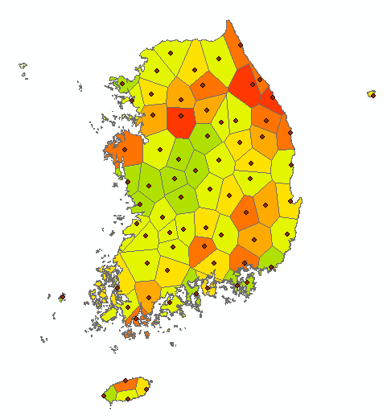
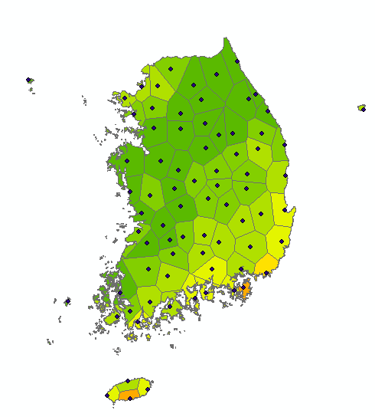
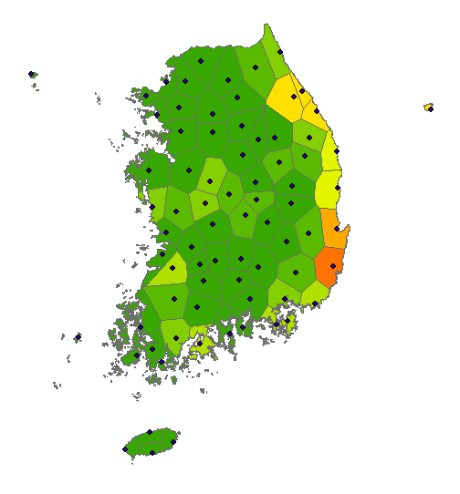
Characterics of Typhoon Patternns
Type of Typhoon Trajectories (South-East Sea)
누적 강수량 분포 : 30-270 1000Mton
CAITLIN (9109)
MIREILLE (9119)
PERCY (9306)
ROBYN (9307)
BART (9918)
SOUDELOR (0306)
NABI (0514)
CAITLIN (9109)
MIREILLE (9119)
PERCY (9306)
ROBYN (9307)
OLIWA (9719)
BART (9918)
SOUDELOR (0306)
SONGDA (0418)
NABI (0514)

Slide 16
Characterics of Typhoon Patternns
Type of Typhoon Trajectories (South-East Sea)

Slide 17


Slide 18


Slide 19



Slide 20


Slide 21


Slide 22


Slide 23


Slide 24


Slide 25


Slide 26


Slide 27


Slide 28


Slide 29


Slide 30


Slide 31


Slide 32


Slide 33


Slide 34


Slide 35


Slide 36


Slide 38


Slide 39


Slide 41


Slide 42


Slide 43


Slide 45


Slide 46


Slide 47


Slide 48


Slide 49


Slide 50


Slide 51

Trajectory of Typhoon Malou (2010.9.7 04:00)

Slide 52
Thank you…
Dr. Waon-Ho(Tiger) Yi
Chair of WGDRR
Prof. of Kwangwoon University
Former Director of NIDP

